Slide 1

CI/CD with Jenkins
Singaravelan Raja

Slide 2
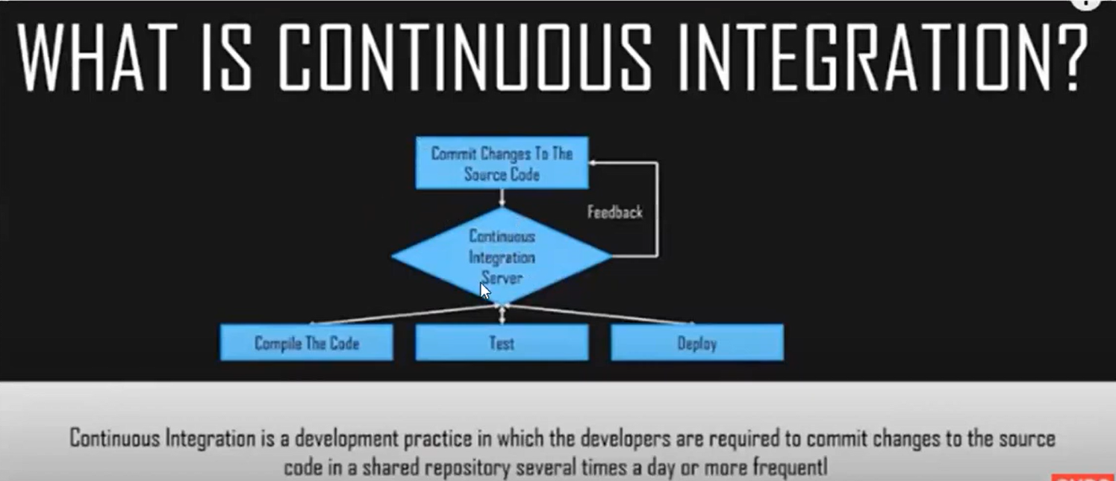

Slide 3
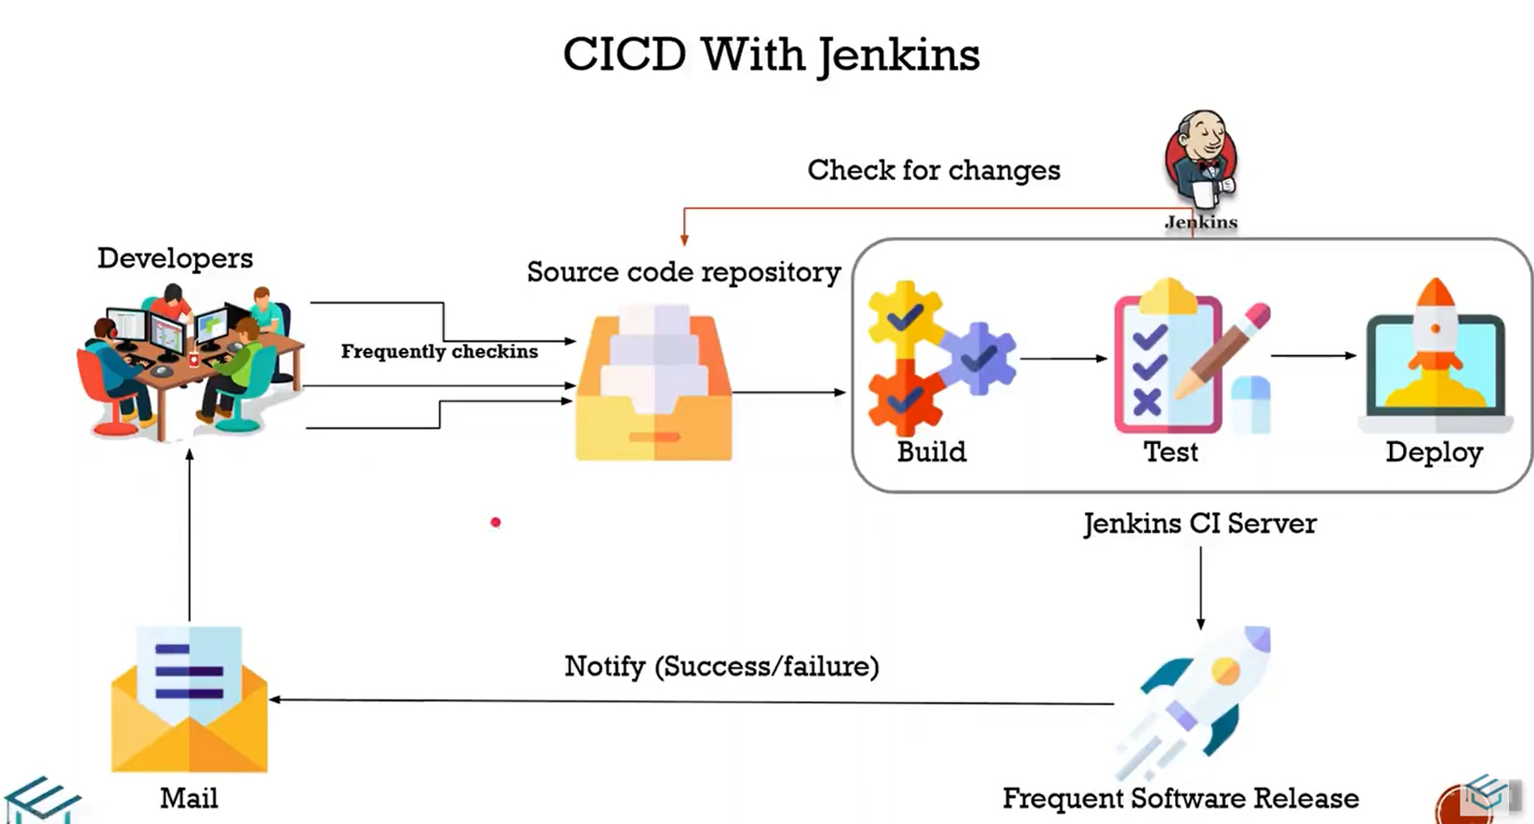
On the next step, you will need to choose the assessment tool you want to use. This can be the Microsoft tool or a third-party provider. In my case, I choose the Microsoft assessment tool. If you only want to migrate, you can also skip this step

Slide 4
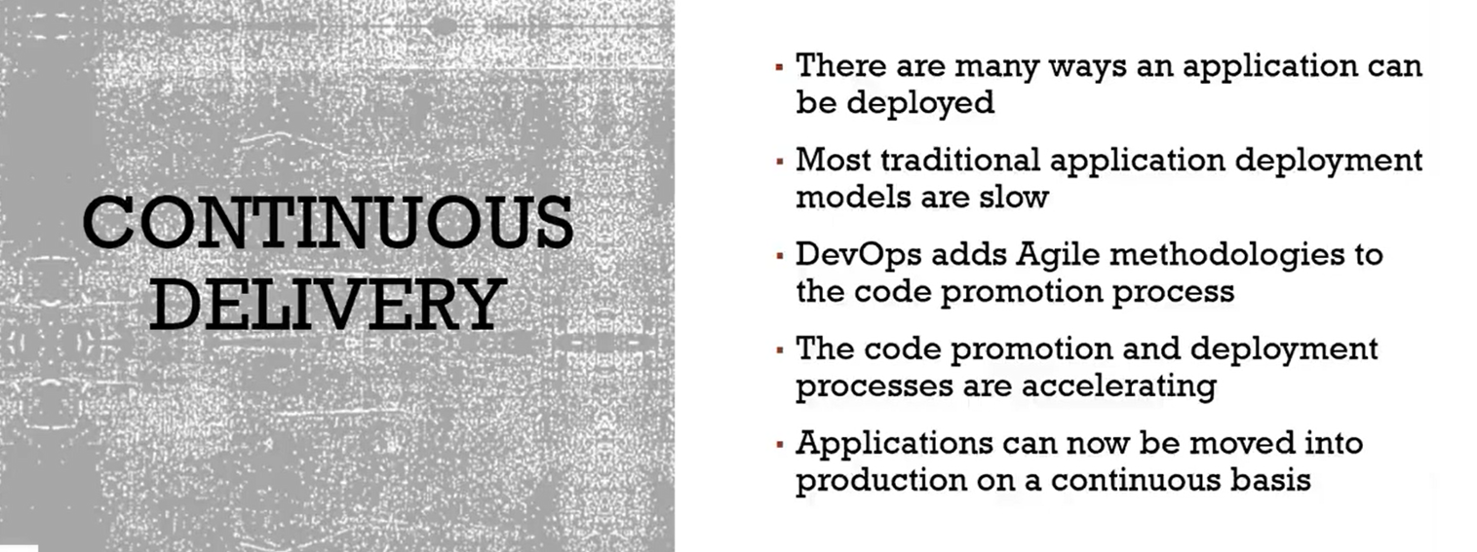

Slide 5
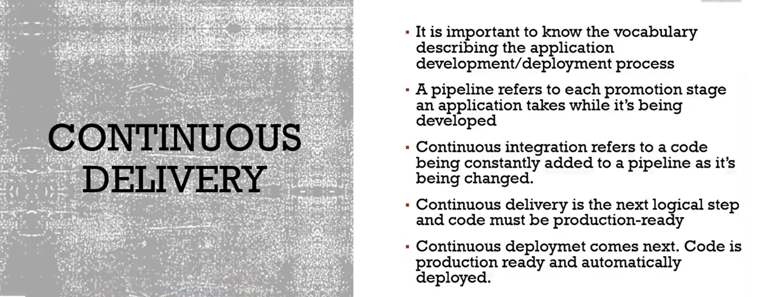

Slide 6
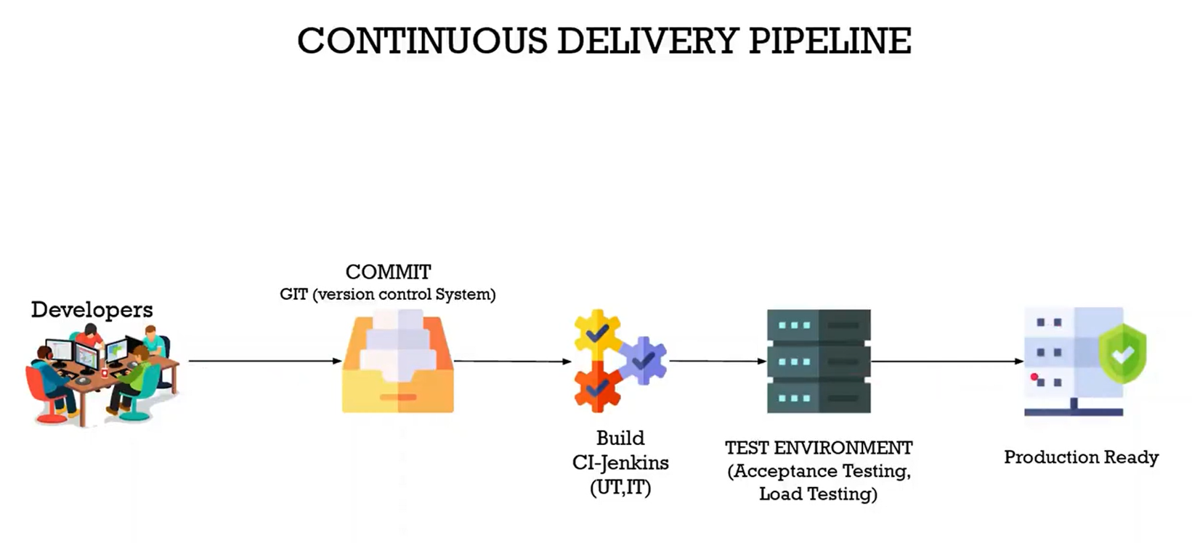

Slide 7
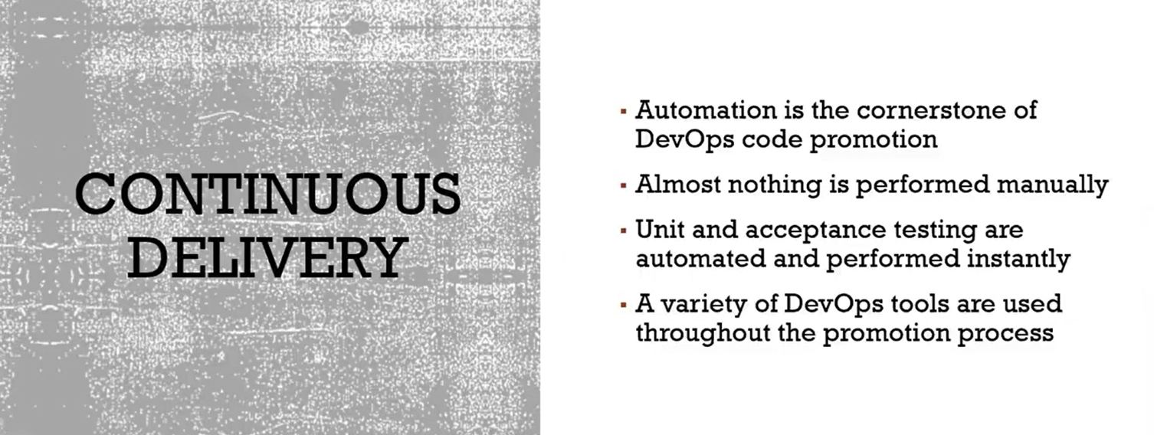

Slide 8
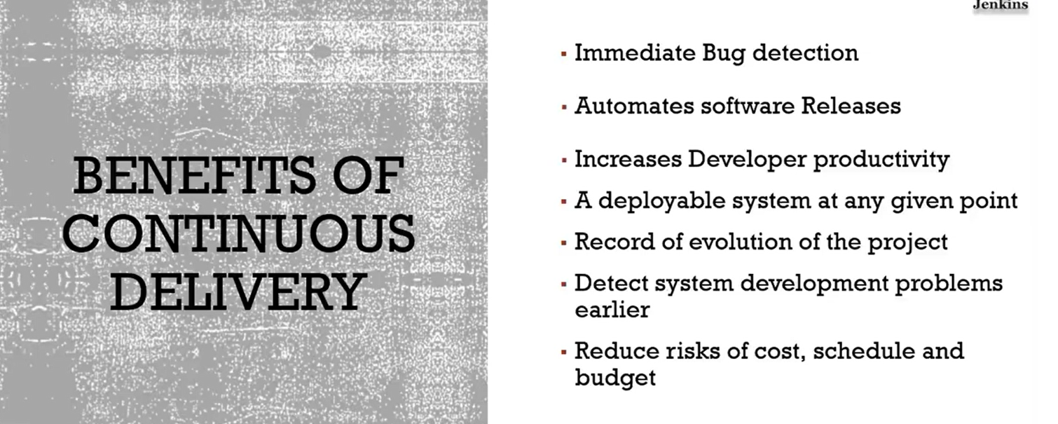

Slide 9
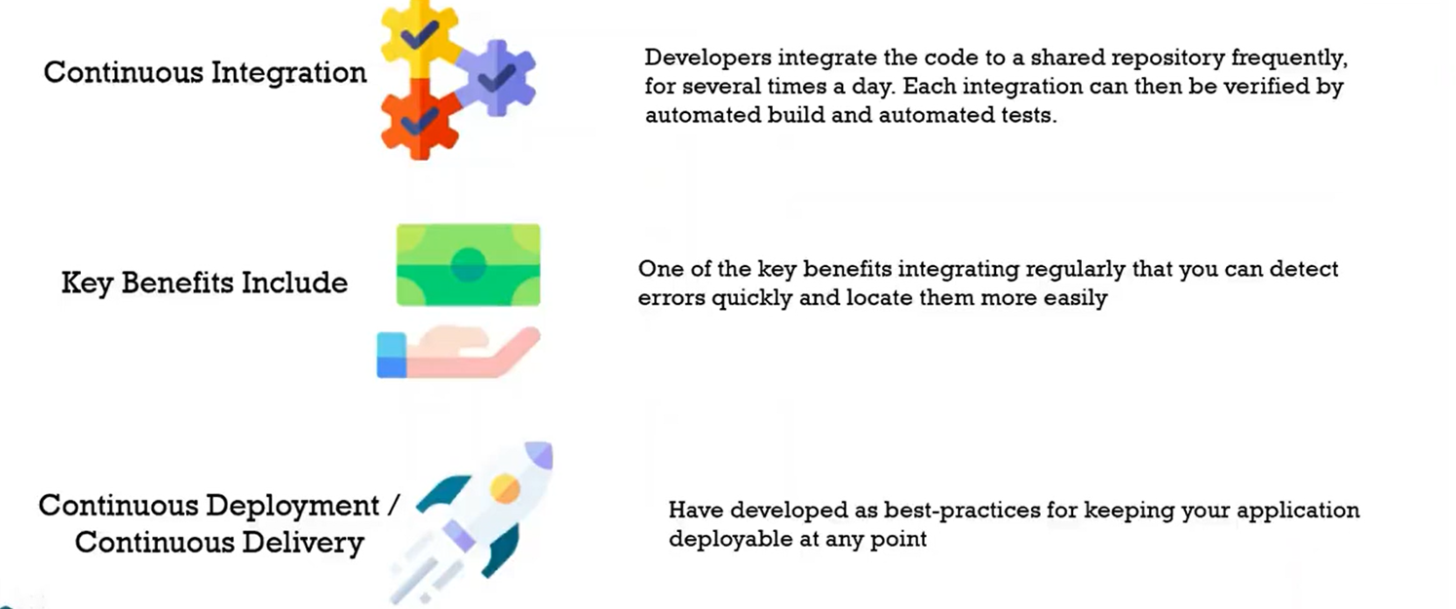

Slide 10
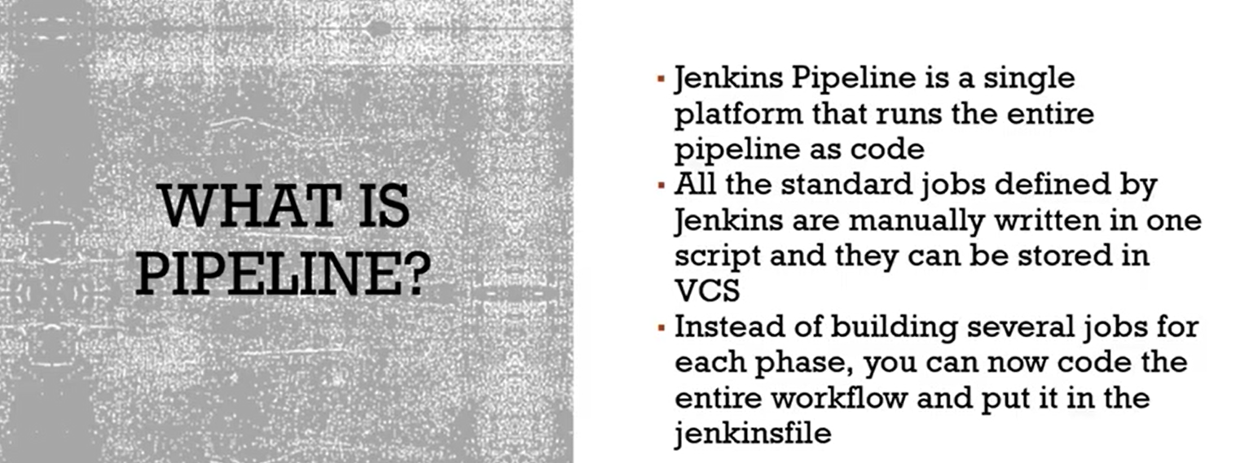

Slide 11
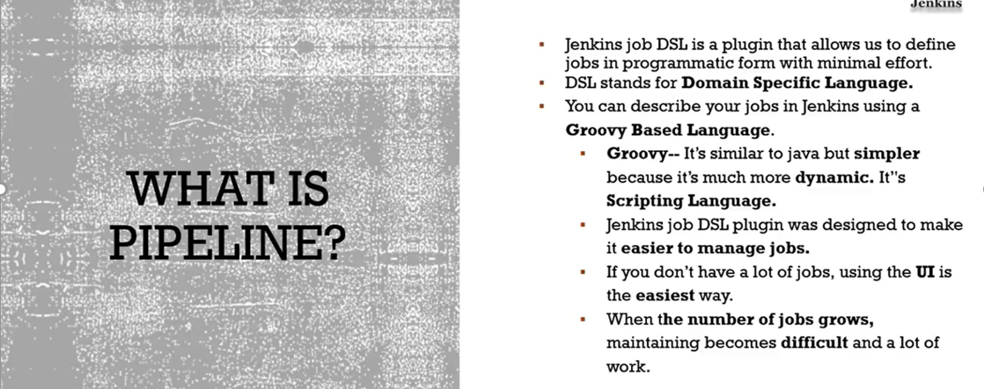

Slide 12
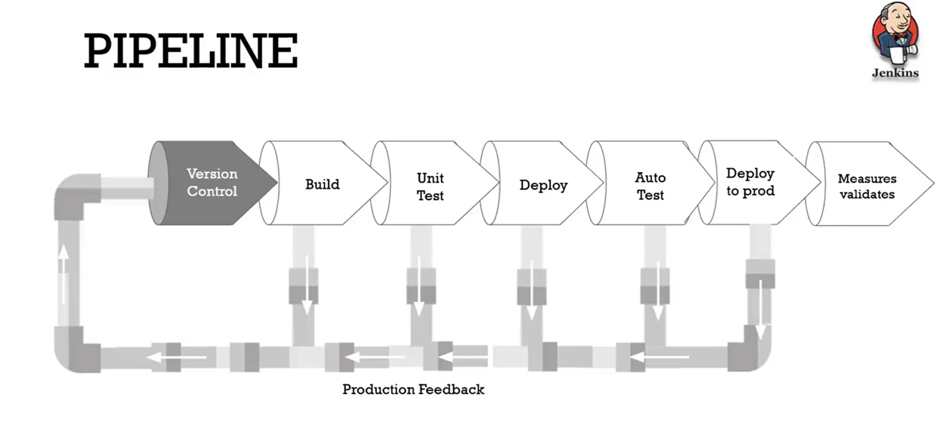

Slide 13
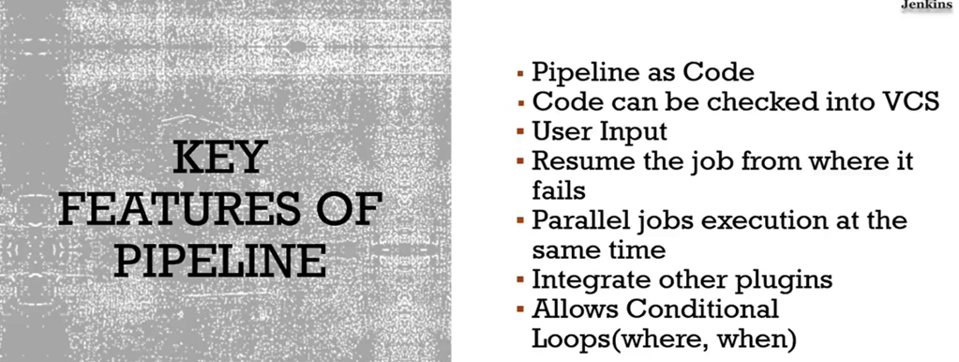

Slide 14
On the next step, you will need to choose the assessment tool you want to use. This can be the Microsoft tool or a third-party provider. In my case, I choose the Microsoft assessment tool. If you only want to migrate, you can also skip this step
Azure DevOps Vs Jenkins
Azure DevOps is Paas and Jenkins need to host on server
Dependancy softwares Installation
Pipeline compatibility like java
License
Jenkins plugins advantage

Slide 15




Developer
CI-CD Pipeline with Jenkins Diagram
Code Commit
Continuous Deployment
Code Checkout from Github repo
Github
Build War/jar File
Prod
1
2
3
4
Trigger Jenkins Pipeline
Tomcat Server

Slide 16
On the next step, you will need to choose the assessment tool you want to use. This can be the Microsoft tool or a third-party provider. In my case, I choose the Microsoft assessment tool. If you only want to migrate, you can also skip this step
CI Demo Pre-requisites
Jenkins setup
Jenkins to be installed on Ubuntu VM
Github repository - https://github.com/sachinchandi55/jenkinsdemo
Java 1.8.0
Apache maven
Git client
Deploy to container plugin on Jenkins console

Slide 17
On the next step, you will need to choose the assessment tool you want to use. This can be the Microsoft tool or a third-party provider. In my case, I choose the Microsoft assessment tool. If you only want to migrate, you can also skip this step
CI Demo Pre-requisites
Tomcat Server setup
Linux VM
Java 1.8.0
Tomcat 9.X

Slide 18
On the next step, you will need to choose the assessment tool you want to use. This can be the Microsoft tool or a third-party provider. In my case, I choose the Microsoft assessment tool. If you only want to migrate, you can also skip this step
CI-CD on Jenkins
On Jenkins server
Install Maven
sudo apt install maven
mvn -version
Install git
sudo add-apt-repository ppa:git-core/ppa
sudo apt-get update
sudo apt-get install git
git –version

Slide 19
CI-CD on Jenkins
Install Jenkins Plugin on Jenkins console
Install “Deploy to container” plugin (This plugin use to install .war file on tomcat server
Install Tomcat 9 on Linux App server
How to install apache tomcat on Linux RHEL 8 / CentOS 8 - Linux Tutorials - Learn Linux Configuration
Install Java-1.8.0-devel
wget https://www-us.apache.org/dist/tomcat/tomcat-8/v8.5.37/bin/apache-tomcat-8.5.37.zip

Slide 20
Freestyle Project
Add git repo
Add main branch
Add tomcat credentials
On Tomcat Server-
/opt/apache-tomcat-9.0.64/conf
Add below username and roles in tomcat-user.xml
<role rolename="admin-gui"/>
<role rolename="manager-gui"/>
<role rolename="manager-script"/>
<user username="admin" password="admin" fullname="Administrator" roles="admin-gui,manager-gui,manager-script"/>

Slide 21
Freestlye Project
Build
Invoke Top level maven targets – clean install
Post Build Actions – Deploy war with container
War/ear file - **/*.war
Context – anything your choice – Freestyle-webapp
Container – Select tomcat 9
Add credentials
Add tomcat url
Add allow="^.*$“ in /opt/apache-tomcat-9.0.64/webapps/manager/META-INF/context.xml

Slide 22
Freestlye Project
Tomcat manager app
Go freestyle-webapp
Servlet – Hello

Slide 23
Declarative Method by Jenkinsfile
Create pipeline
Add Git repo
Change the branch to main
Update the jenkinsfile

Slide 24
Declarative Method by Jenkinsfile
Go to tomcat manager app
Open pipeline-app
Servlet Hello

